Slide 1


SPACE DEBRIS GENERATION AND ORBITAL PROPAGATION PREDICTION USING AI/ML
A Case Study on Real-World Data Limitations in Orbital Decay Predictions

Slide 2
Student Team
Truc Nguyen
Ravindu Guruge
Ashwin Sreejith
Vivek Aggarwal
Industry Supervisor
Dr. Abhiram Jayan Nair (CEO ERETS)

Slide 3
Introduction
Truc

Slide 4
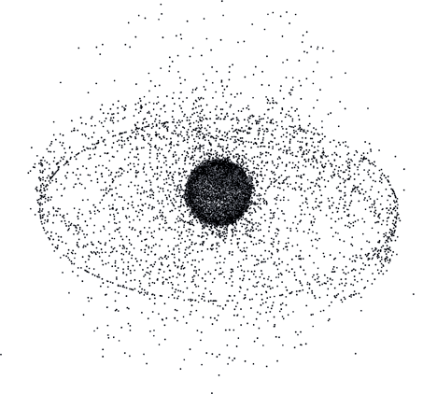
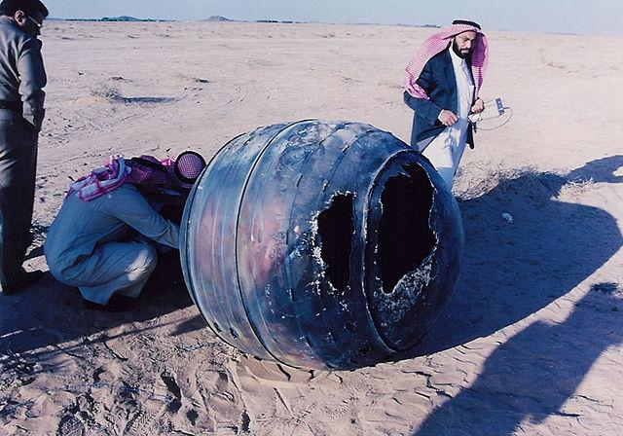
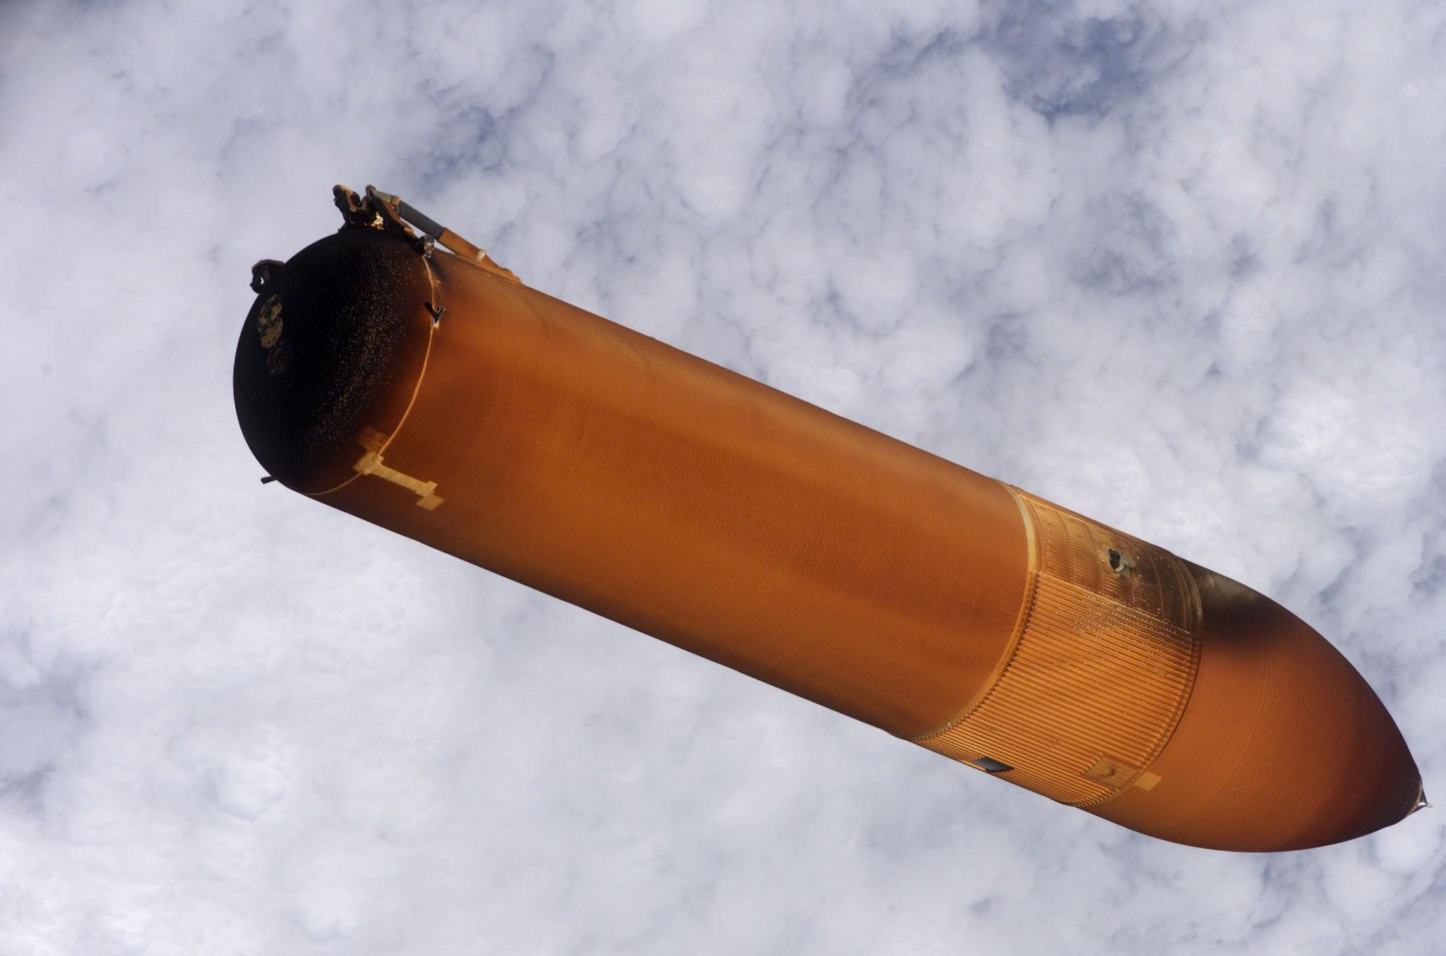
Introduction
ERETS Space Ltd
HQ: London, UK
Mission: Space Debris Management
Focus: Debris tracking and prediction using AI/ML

Slide 5
Introduction
Initial Goal:
AI/ML system for debris prediction
Adjusted Focus:
Comprehensive case study
Strategic insights for future development

Slide 6
Data Collection & Preprocessing

Slide 7
Data Collection Process
Website
Website
Json

Slide 8
What Data We Collected
Satellite Catalog (SATCAT)
Basic object information
Launch dates
Country of origin
General Perturbations (GP) Data
Detailed orbit information
Object locations
Movement patterns

Slide 9
Data Cleaning & Preprocessing
Missing values in DECAY and omm_data → Filtered out incomplete records
Columns with identical values but different names → Identified and removed based on manual inspection
Columns with single unique value → Removed as non-informative
Time Analysis Required → Created LIFETIME_DAYS from DECAY and LAUNCH dates

Slide 10
Models & Technical Approach
Ashwin

Slide 11
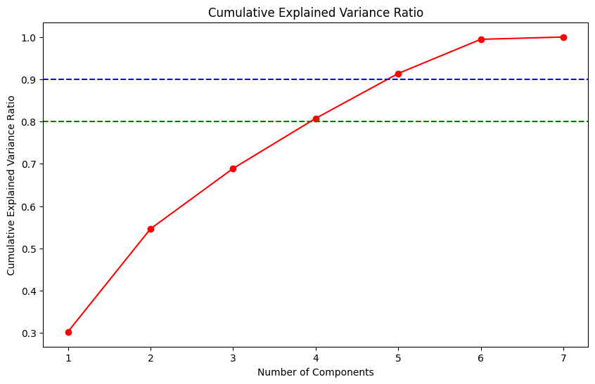
Principal Component Analysis
Total 20 features (Including OMM)
Complicated relationships between features
Dimensionality reduction
PCA chosen features
“APOGEE, PERIOD, INCLINATION,
OBJECT_TYPE, PERIGEE, RCS_TYPE
EPHEMERIS_TYPE”

Slide 12
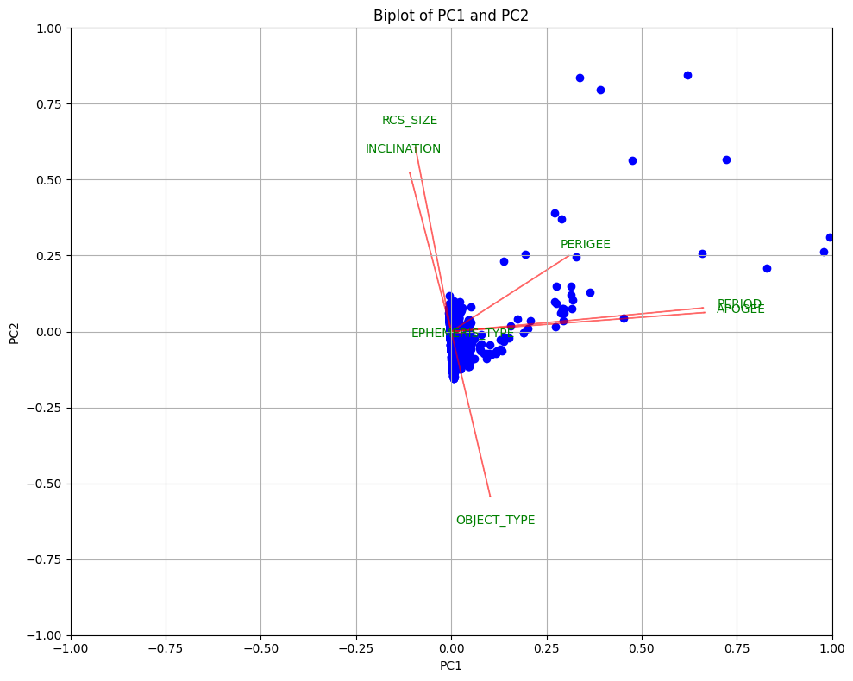
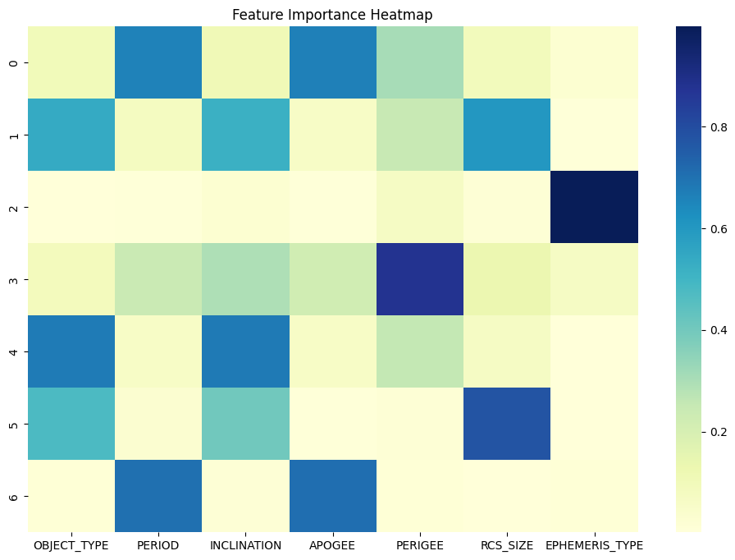
PC1 Vs PC2 & Feature Importance Heatmap

Slide 13
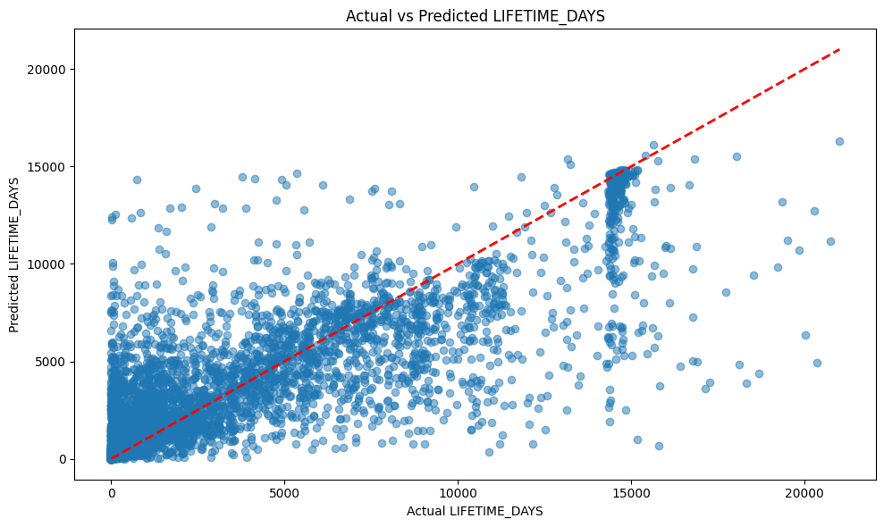
Regression Approach (Statistical Models)
Trained 7 regression models
Random Forest, Gradient Boosting, K-Nearest Neighbors, Elastic Net, Ridge, Lasso and Polynomial regression.
Best performance :- Random Forest (RMS Error : 6.4 years)

Slide 14
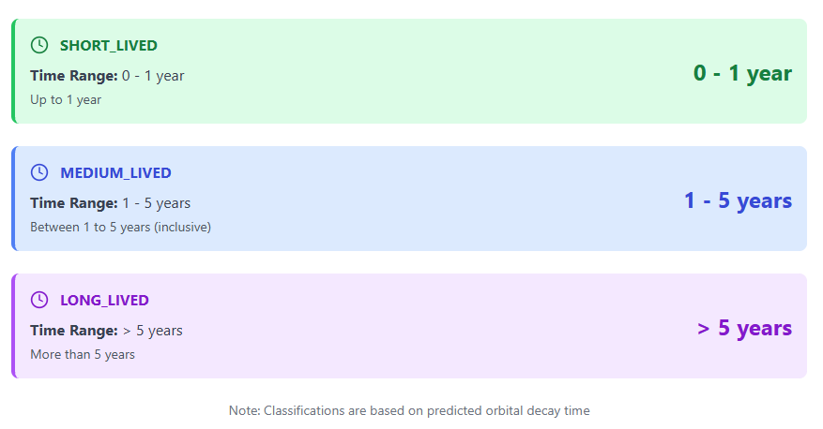
Classification Approach

Slide 15
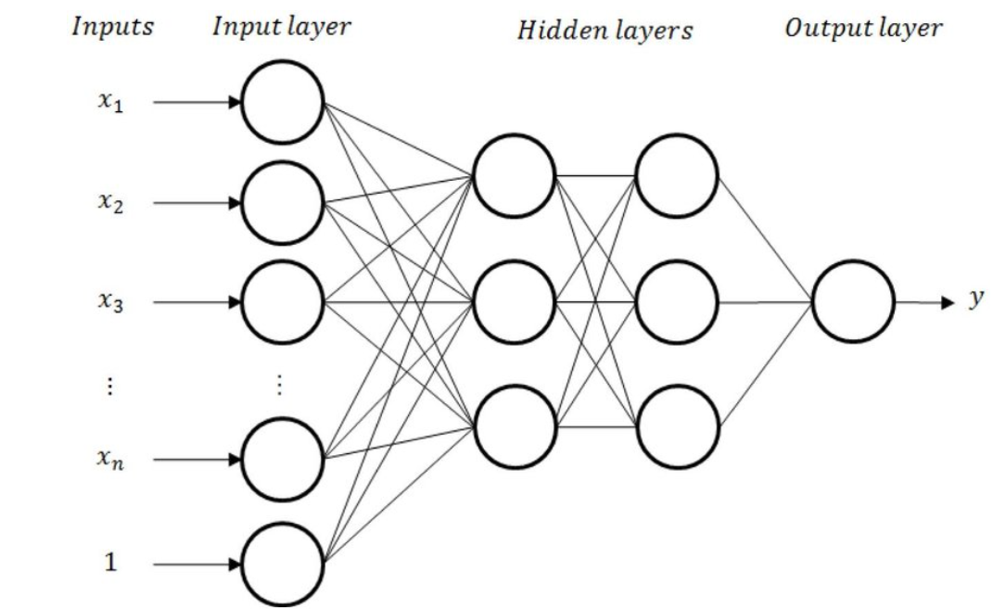
Multi-Layer Perceptron Regressor (MLP)
Vivek
Setup
Initial trials with an MLP Regressor model as a benchmark.
Basic feedforward with default configurations.
Model Enhancement
Activation functions
Validation Strategy
Performance Evaluation
Flow diagram for a basic MLP
Validation score -> 0.44
Mean R-squared -> 0.0886
Standard Deviation ->(+/- 0.5253)

Slide 16
Tensorflow Implementation
Need?
Architecture Overview
Enhanced Architecture using Keras
Several dense layers with different sizes—256, 128, 64, 32, and 16 neurons
Dynamic Model Building
Training Techniques
ReduceLROnPlateau
Batch Size.
RandomSearch
Adam optimizer
Mean Absolute Error: 1454.66 (~4 years)
R-squared Score: 0.6816

Slide 17
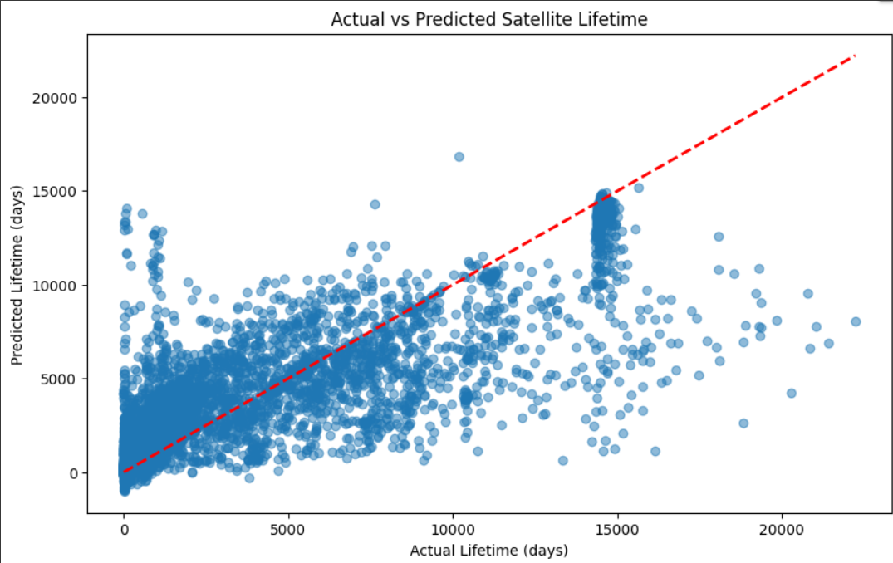
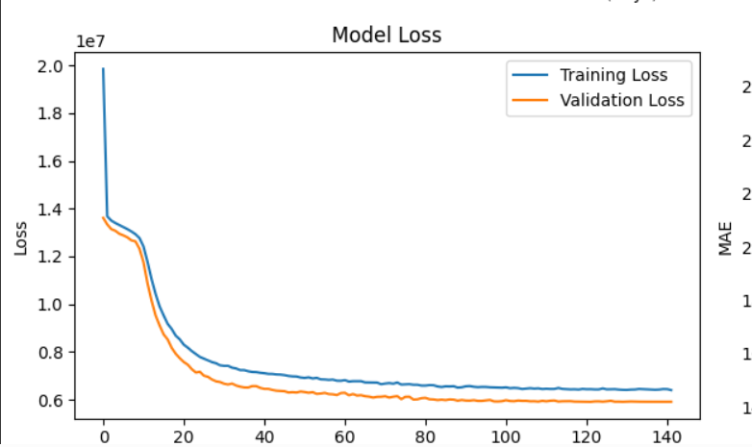
For a visual understanding

Slide 18
Results, Challenges & Future Work
Ravindu

Slide 19
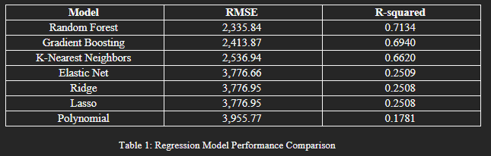
Key Evaluation Metrics
Regression Models Performance
Random Forest: RMSE of 2,335.84 days (~ 6.4 years), R² = 0.7134.
Neural Network slightly underperformed; RMSE of ~6.8 years
Ridge and Lasso had very low R². (~ ⅓ Random forest’s R²)

Slide 20
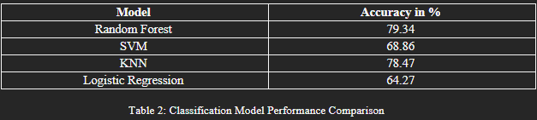
Key Evaluation Metrics
Classification Models Performance
Highest accuracy with Random Forest (79.34%).
K-Nearest Neighbors (KNN) had balanced recall but lower accuracy (78.47%).
Support Vector Machine and Logistic Regression struggled with Medium-lived class.

Slide 21
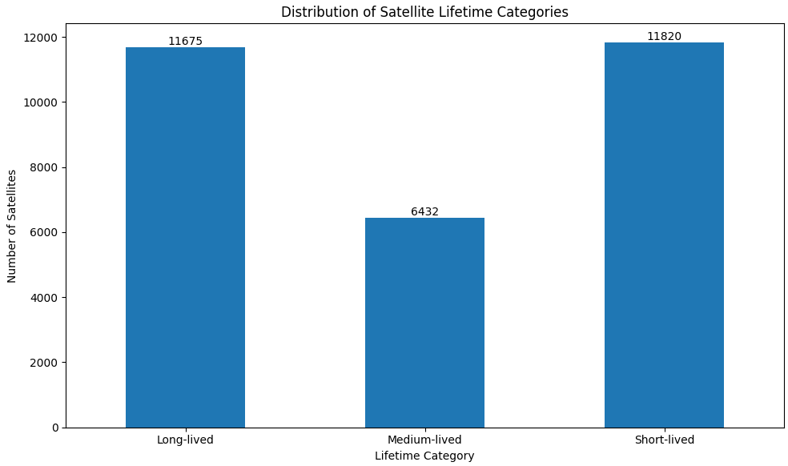
Analysis and Challenges
Data Limitations: Lack of critical data like mass and radar cross-section (RCS).
Domain Complexity: Space debris decay influenced by complex physics.
Class Imbalance: Medium-lived class hardest to predict due to fewer samples.
Model Selection: Ensemble and instance-based models like Random Forest and KNN handled non-linear decay patterns best
Notes:
cross-sectional area, reflective index and mass (missing critical data)

Slide 22
Further Improvement
Proposed Idea
Build a mathematical model that predicts decay of a space object based on altitude (100 km as threshold).
Build a learning dataset with precise decay dates from a simulated scenario.
Train a Neural Network on this learning database. (RNN, LSTM, etc)
Fine tune on the real-time data.
Simulation Information
20 Satellites, 400 data instances, 27 known debris.
Known values of cross-sectional area, reflective index and mass.

Slide 23
THANK YOU

